Slide 1
Topic : How to install Laravel
By – Debasish Sahoo

Slide 2
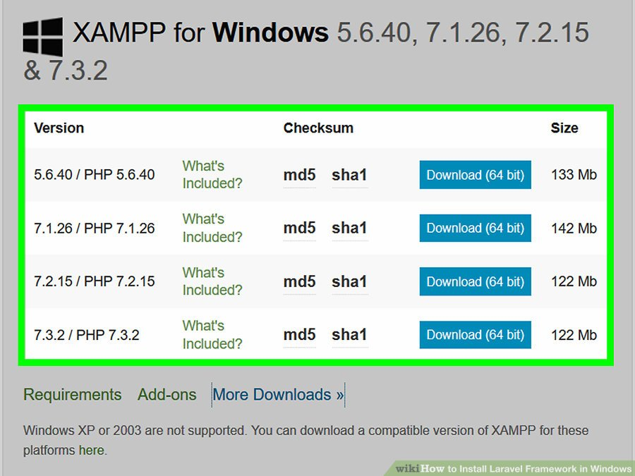
Open the XAMPP doewnload page.

Slide 3
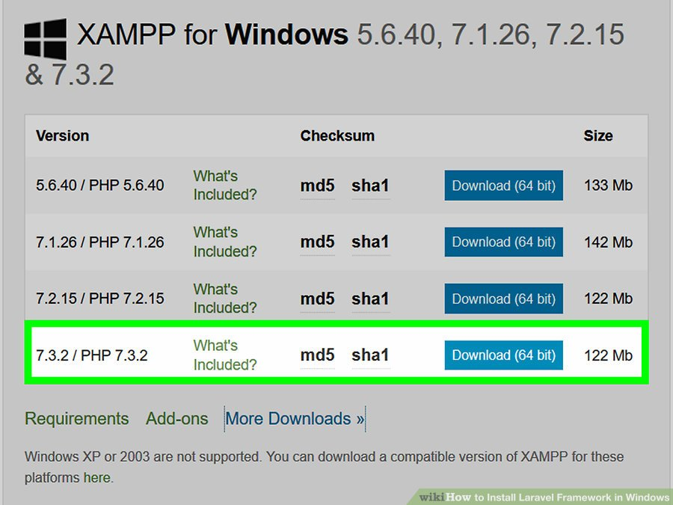
Scroll down to the "7.2.8 / PHP 7.2.8" heading. You'll find it near the bottom of the list of downloads.This is important; since Laravel requires PHP 7.13 or higher, you'll need to make sure you don't accidentally install an older version of XAMPP.

Slide 4
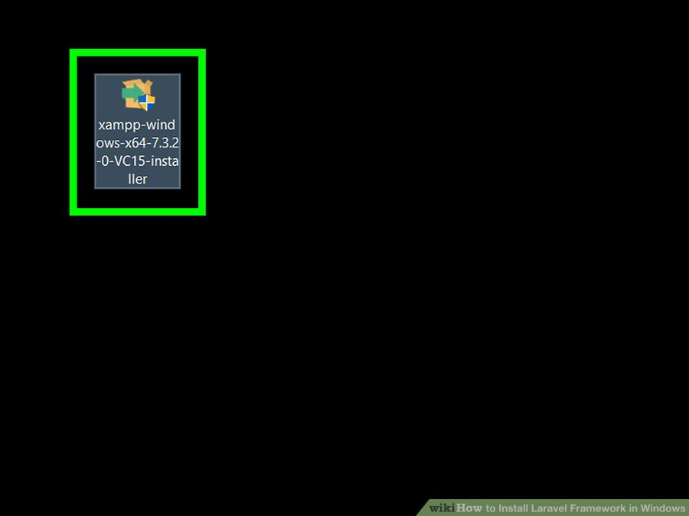
Click download 32 bit.
It's a blue button to the right of the "7.2.8 / PHP 7.2.8" heading. This will download the XAMPP setup file onto your computer.

Slide 5
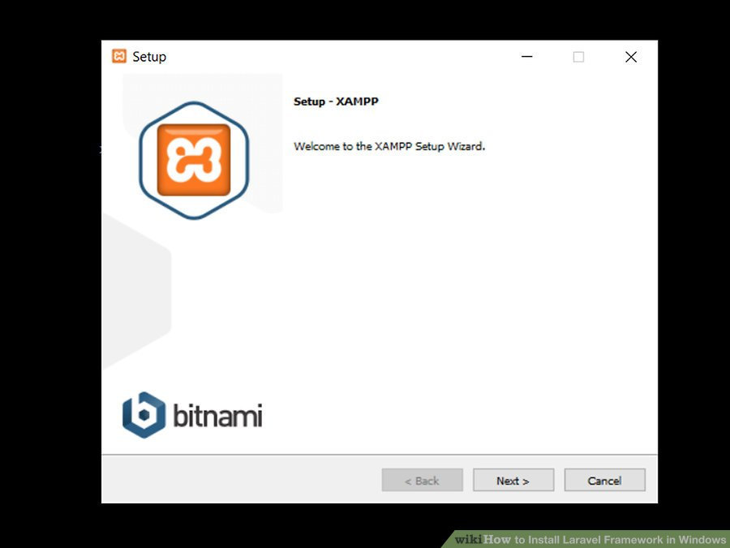
Open the XAMPP setup file. Double-click the downloaded setup file to do so.

Slide 6
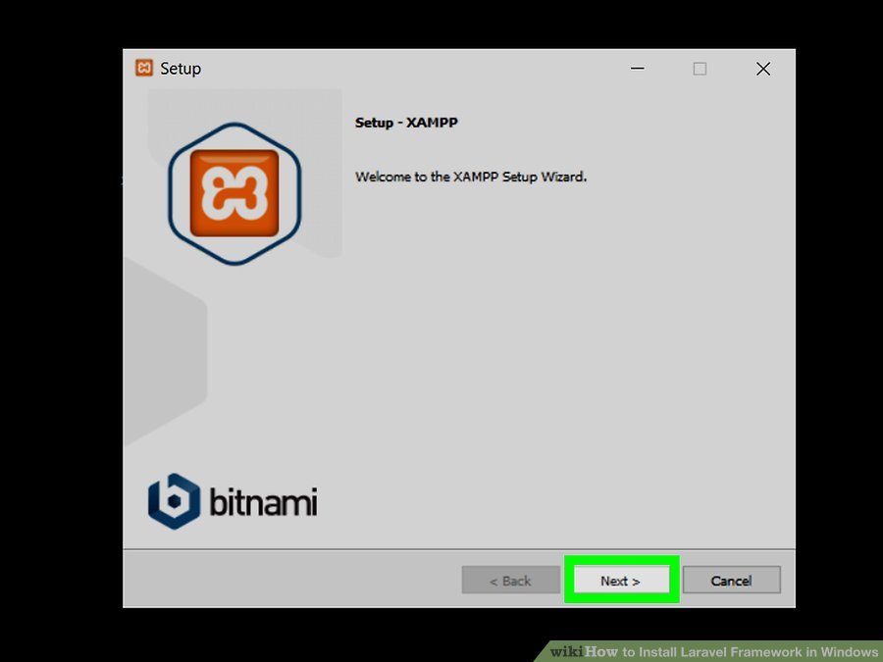
Click Yes when prompted.
This will open the XAMPP setup window.

Slide 7
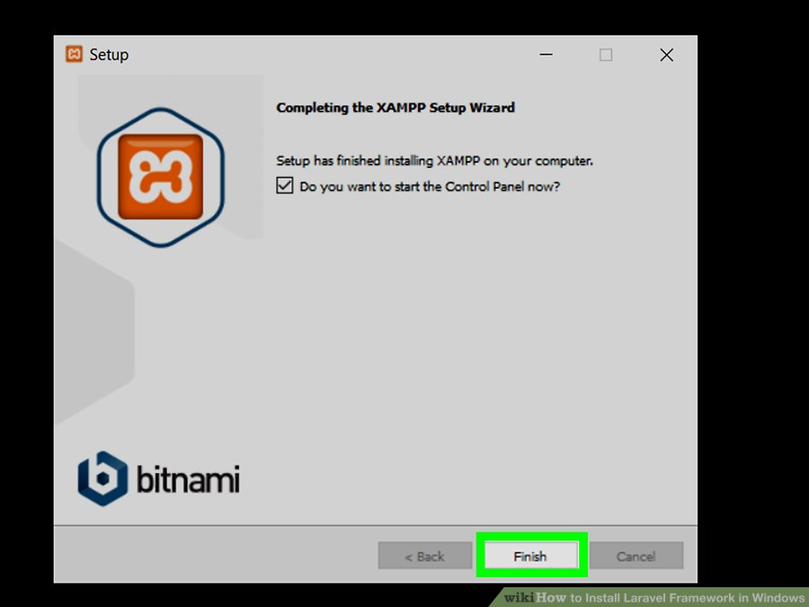
Navigate through the XAMPP setup process. Click through the XAMPP menus by doing the following:Click Next three times.
Uncheck the "Learn more about Bitnami for XAMPP" box.
Click Next twice.

Slide 8
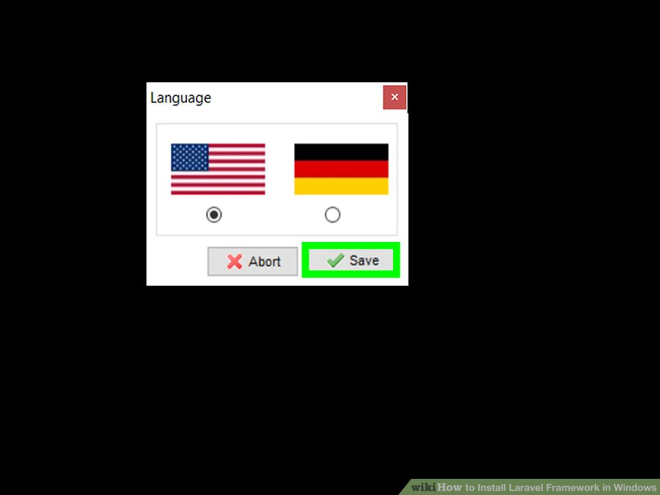
Click Finish when prompted. This will open the XAMPP language preferences pop-up window.

Slide 9
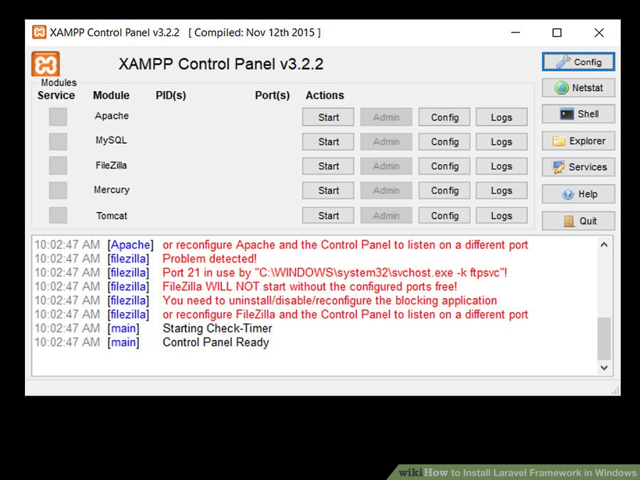
Click Save when prompted. Doing so will save your default language settings and open the XAMPP dashboard.

Slide 10
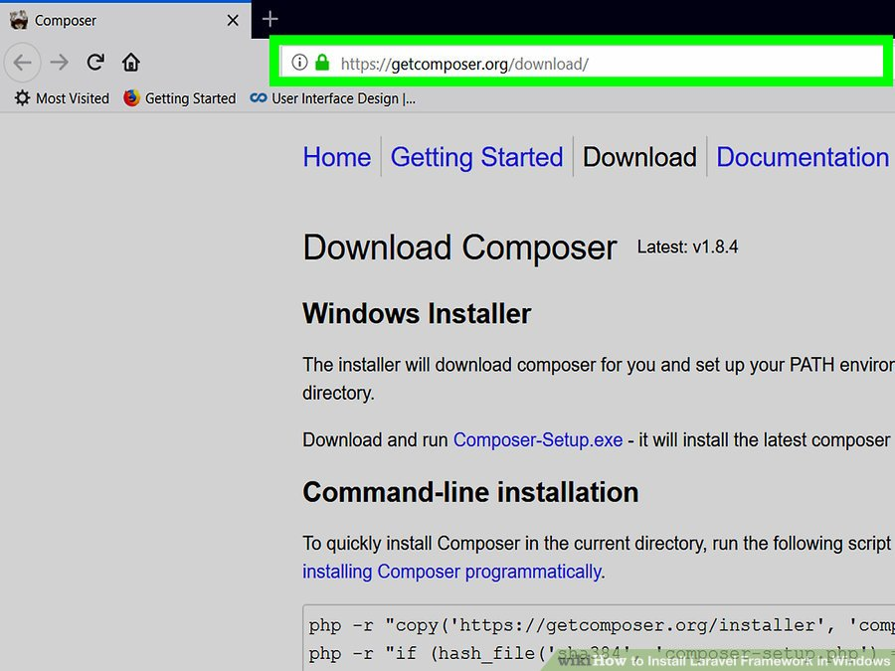
Start Apache. Click Start to the right of each of the "Apache" heading. This will turn on Apache. At this point, you're ready to install Composer.You can also do the same with the "MySQL" heading, but you'll need to have MySQL installed in order to do so.

Slide 11
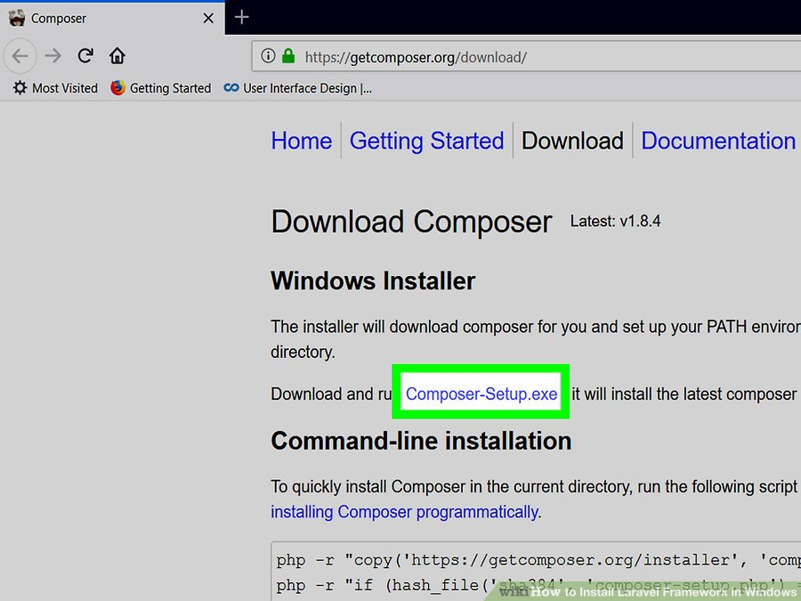
Open the Composer website. Go to https://getcomposer.org/download/ in your computer's web browser.

Slide 12
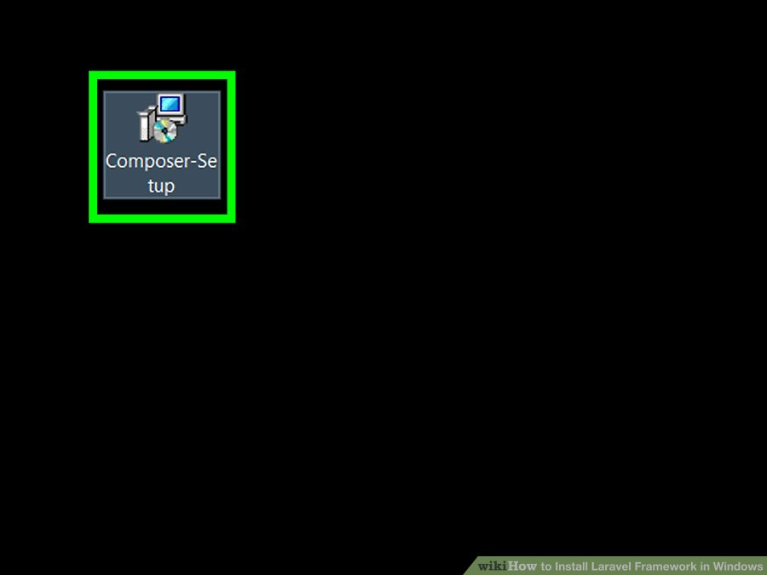
Select the Composer download link. Click the Composer-Setup.exe link near the top of the page.

Slide 13
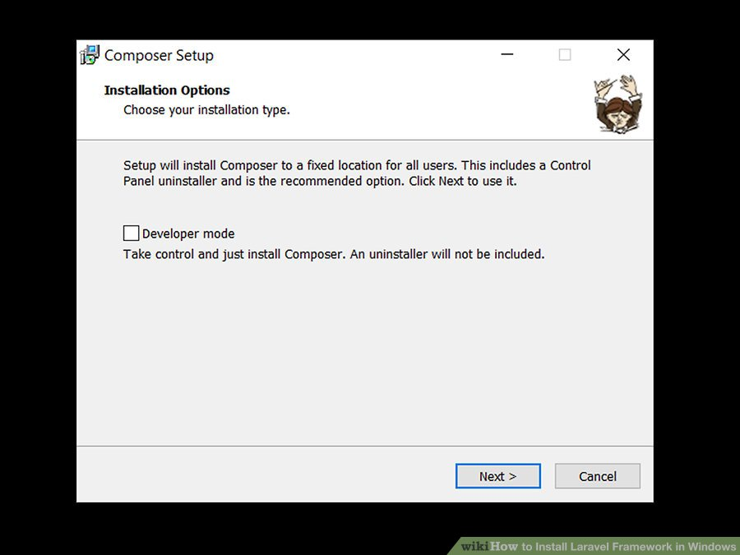
Open the downloaded Composer setup file. Double-click the "Composer-Setup" file to do so.

Slide 14
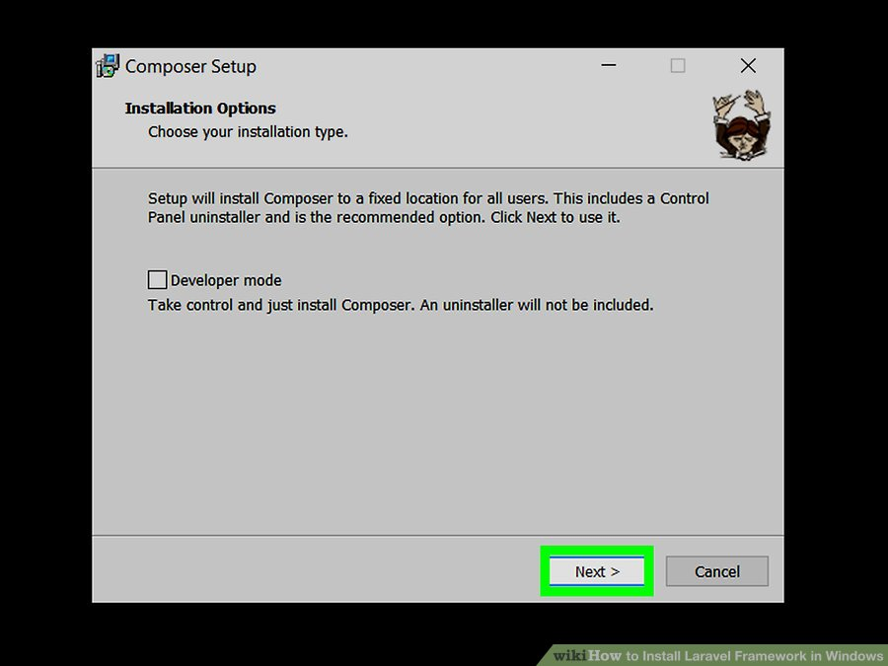
Click Yes when prompted. This will open the Composer installation window.

Slide 15
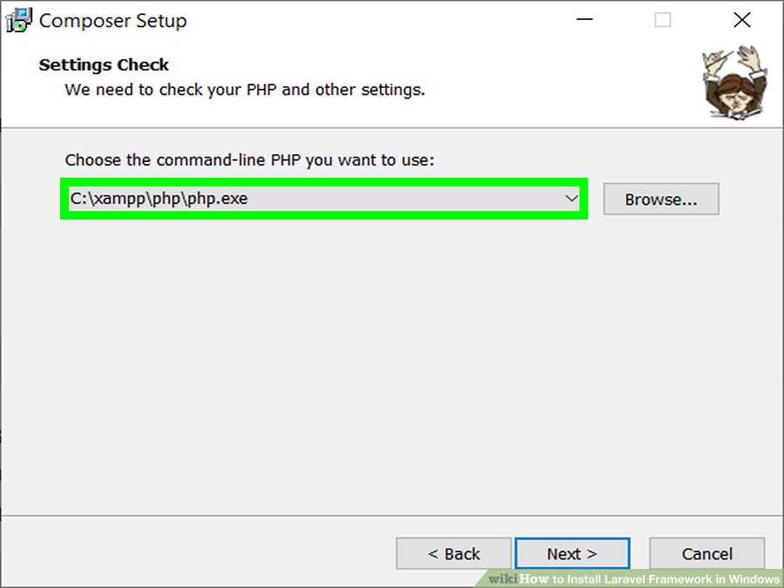
Click Next. It's at the bottom of the window.

Slide 16
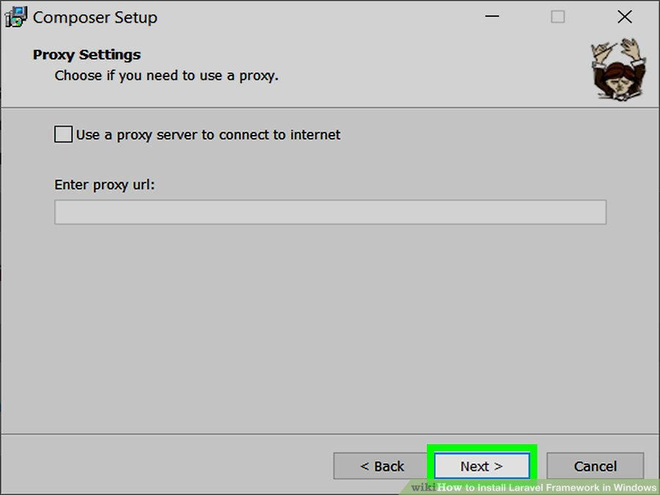
Select XAMPP if necessary. If you have multiple different command line-based PHP options installed on your computer, click the one listed in the drop-down box at the top of the window, then click C:\xampp\php\php.exe in the drop-down menu.

Slide 17
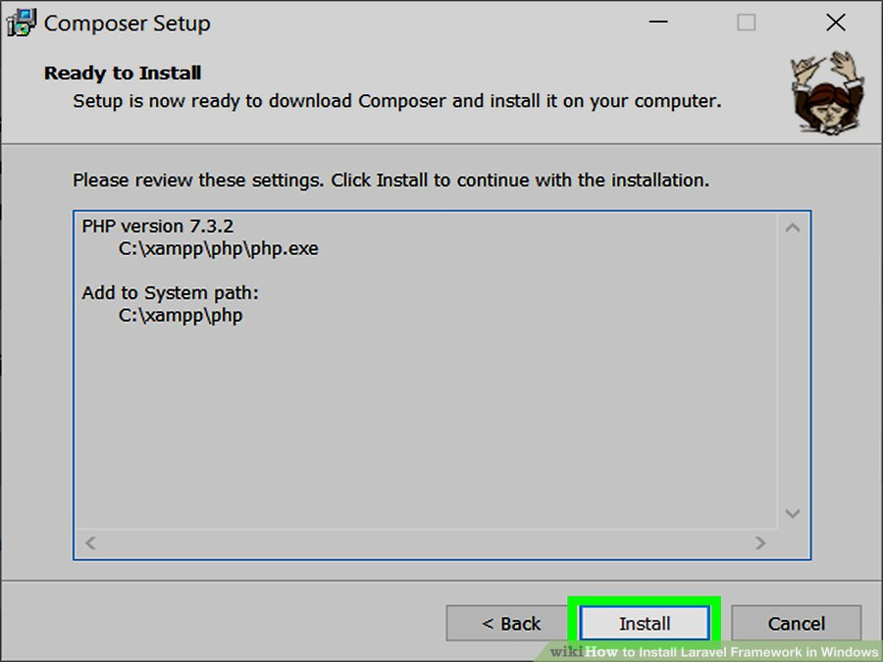
Click Next twice. This option is at the bottom of the menu.

Slide 18
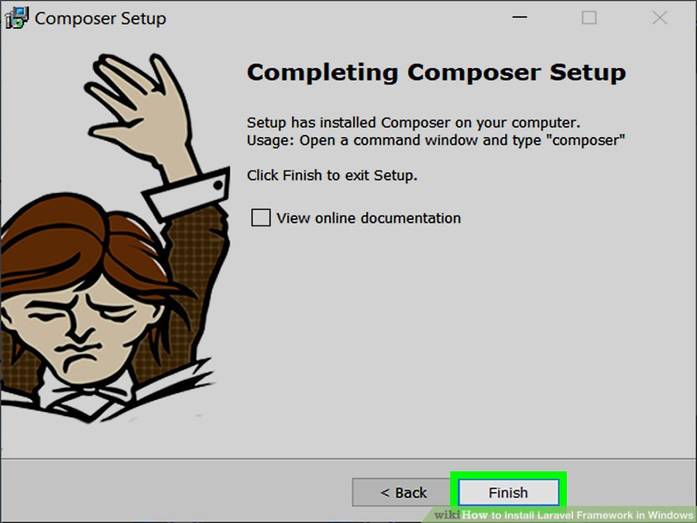
Click Install. It's at the bottom of the window. Composer will begin installing.

Slide 19
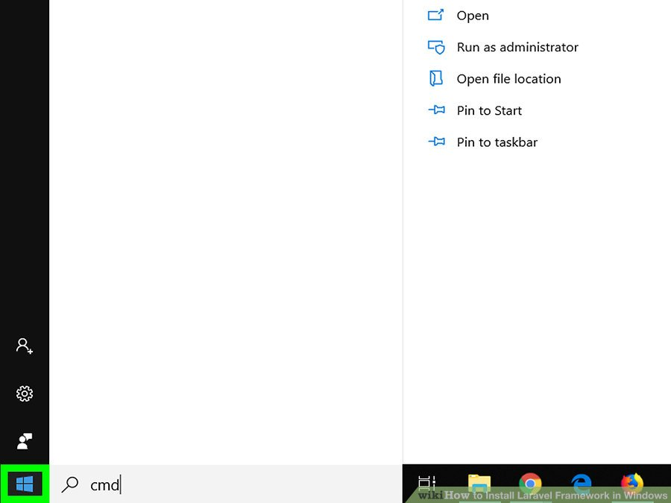
Click Finish when prompted. Doing so signifies that Composer has been installed successfully.

Slide 20
INSTALL LARAVEL
Now its time to install Laravel on our system using composer. This can be done by running the below command in the Command prompt.
composer global require "laravel/installer"

Slide 21
CREATING NEW APPLICATION
After successful installation of Laravel, we can create a new app with the below command. AwesomeProject is the name of the project I want to create.
composer create-project --prefer-dist laravel/laravel AwesomeProjectNow, wait for some time to complete the creation process.

Slide 22
CHOOSING THE CODE EDITOR (OPTIONAL)
We can choose our favorite code editor for working with the project. But I personally recommend Visual studio Code(VS code). It can be downloaded with the link below.
https://code.visualstudio.com

Slide 23
CREATING DATABASE
Now we need to create a database for our project in our MySQL server. This can be easily done using phpMyAdmin.
Open the link below.http://localhost/phpmyadmin
Now Enter username and password(As a default, the username will be root password will be empty).
Click on the New tab
Enter a database name

Slide 24
MODIFY ENV FILE
We can see a .env file inside the root directory of our project. Add our database details in this file as below.
DB_DATABASE=(The database name you created earlier - awesome_project_db) DB_USERNAME=(Your Mysql username. Default: root) DB_PASSWORD=(Your Mysql password. As a default, blank)

Slide 25
MIGRATE DATABASE
Now we have to migrate the database to the local database we created earlier. This can be done using the command below.
php artisan migrate

Slide 26
RUNNING OUR APPLICATION
Our application can be run using the command below.
php artisan servThis will open up a new tab on our browser with the URL below. This is the home page of our Laravel application.
http://localhost:8000Our app can also be run on another port using the command below.
php artisan serv --port=9000This will open up our application in the port 9000
http://localhost:9000

Slide 27
THANK YOU

